Slide 1
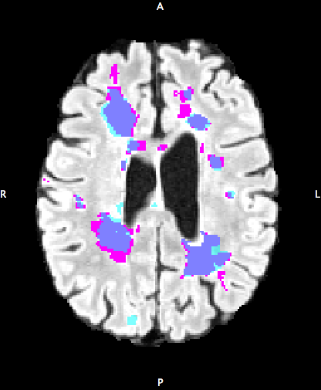
MS Lesion Segmentation using Deep Learning
Masters Thesis by Erol Kazancli,
Supervised by Laura Igual Muñoz,
In collaboration with MintLabs and Hospital Clinic

Slide 2
Outline
Introduction
Objectives
Methodology
Experimental Results
Conclusions
Future Work

Slide 3
1.
INTRODUCTION

Slide 4
Multiple Sclerosis (MS)
Chronic neurological disease
Affects mainly people between 20 and 50
Symptoms such as loss of vision, slurred speech, numbness, fatigue, memory problems...
Causes lesions in the brain, which are visible in the MRI image
Lesion segmentation is important for the diagnosis and the prognosis of the disease

Slide 5
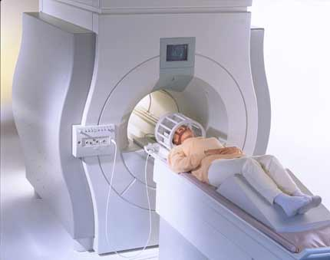
MAGNETIC RESONANCE IMAGING (MRI)
Medical imaging technique
Makes use of magnetic fields, radio waves, field gradients
Forms pictures of the anatomy and processes of the body
Modalities sMRI: T1, T2, FLAIR

Slide 6
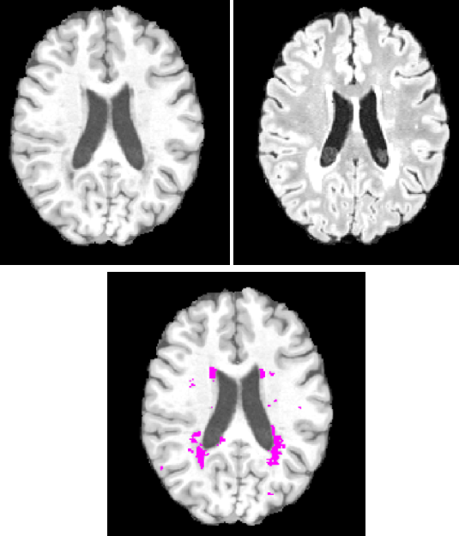
MS Lesion
Caused by the loss of myelin sheath
Generally ovoid in shape
Dark (hypo-intense) regions in T1
Bright (hyper-intense) regions in T2
Difficult to formulate mathematically

Slide 7
MS Lesion Segmentation
Segmentation is important for diagnosis and prognosis of the disease, and treatment development
Mainly done manually by experts
There is a need for automatic or semi-automatic methods
Semi-automatic tools such as LST exist, but have limited performance

Slide 8
2.OBJECTIVES

Slide 9
Objectives
Obtain a model that comes closer to solving MS Segmentation problem
Explore different deep learning approaches and compare them
Outperform commonly used semi-automatic MS Segmentation tool, which is LST

Slide 10
3.METHODOLOGY

Slide 11
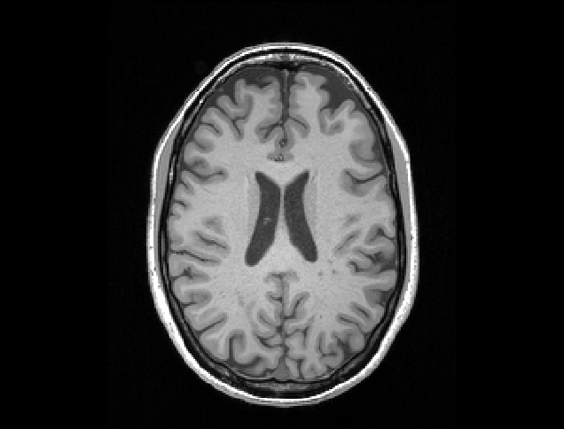
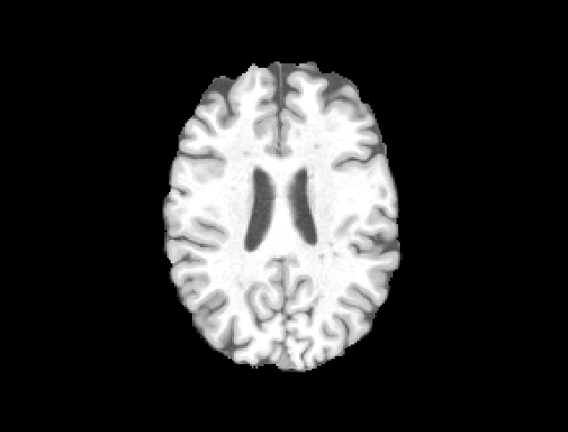
Pre-processing MRI Data
Before
Skull stripping: Removing the skull from images
Field bias correction: Removing undesired signal from images
Motion Correction: Removing the movement effects and co-registration
Intensity Normalization: 0-mean unit variance standardization
After

Slide 12
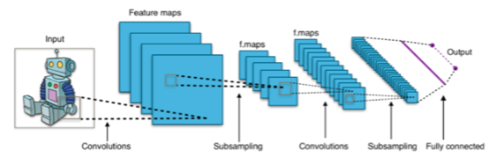
Convolutional Neural Networks (CNN)
A special type of kernel based ANN
Efficiency due to shared kernels
Feature extraction capability
Impressive results in Computer Vision

Slide 13
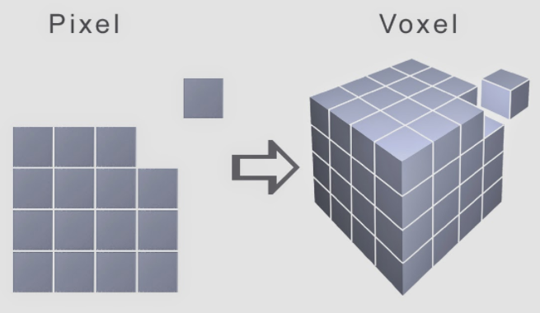
Pillar 1: Patch-based Classification
Segmentation posed as a classification problem
Voxel-by-voxel classification
3D patches extracted around the voxel of interest
The bigger the patch the more information, but higher computational cost
Picture from Voxel Art

Slide 14
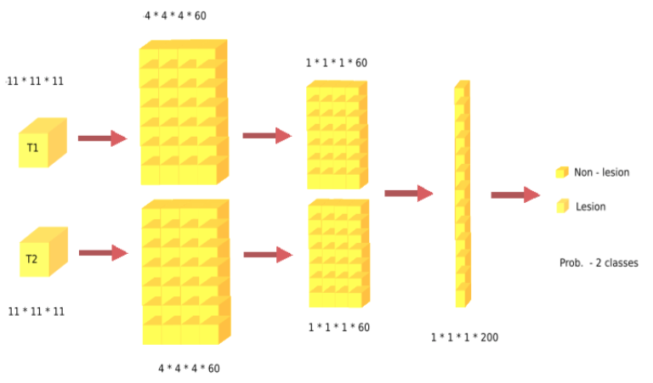
Pillar 2: 3-Layer CNN Architecture
Two branches for T1
and T2 connected at full
layer
Two convolutional layers followed by avg. pooling
Dropout, batch-norm
Adam-optimizer

Slide 15
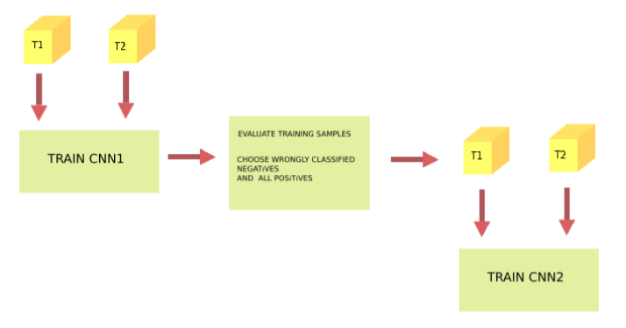
Pillar 3: Cascade Training
Train the first CNN
Evaluate the training samples, sub-sample wrongly classified negative ones
Train the second CNN with these negative samples + all positive samples

Slide 16
Pillar 4: Clever Sub-Sampling
The MS segmentatıon pronlem has a highly imbalanced training set
Very few positive samples compared to negative samples
There is a need to down-size the negative samples but CLEVERLY!
Random Selection? NO
Select from regions very close to lesions? YES

Slide 17
7 Different Approaches
Approach 1: Patch size 11*11*11
Approach 2: Patch size 11*11*11 with Location
Approach 3: Patch size 19*19*19
Approach 4: Patch size 11*11*11 – Cascade
Approach 5: Patch size 11*11*11 – 4 classes
Approach 6: Patch size 11*11*11 – 3 classes
Approach 7: Patch size 11*11*11 – 3 classes and Cascade

Slide 18
4.EXPERIMENT RESULTS

Slide 19
Data Set
59 Subjects from Hospital Clinic
T1, T2 modalities, Tissue Segmentation and Lesion Mask
45 Training, 5 Validation, 9 Test

Slide 20
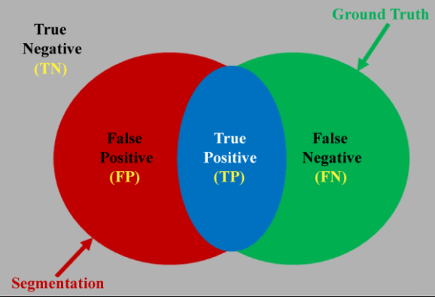
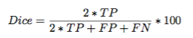
Validation – Dice Coefficient (DSC)
Statistical overlapping
measure

Slide 21
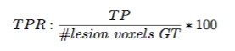
Validation – True Positive Rate (TPR)
Lesion detection rate

Slide 22
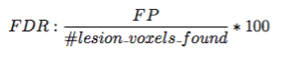
Validation – False Discovery Rate (FDR)
Percentage of false positives in the output segmentation

Slide 23

Validation – Volume Difference (VD)
Absolute difference of volumes as percentage

Slide 24
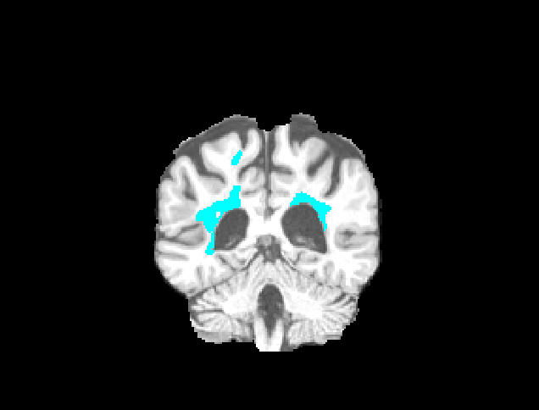
Validation – Connected Components
Connected Components: Groups of lesion voxels that form a mass
#Connected Components Ground Truth
#Connected Components Found
#Connected Components Coincided

Slide 25
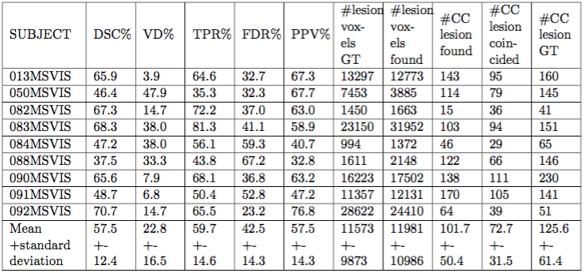
Best Model – Patch 11 – 3 Class and Cascade

Slide 26
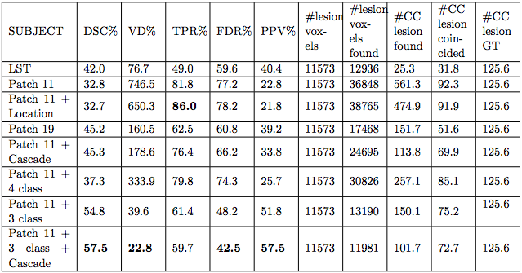
Model Comparison

Slide 27
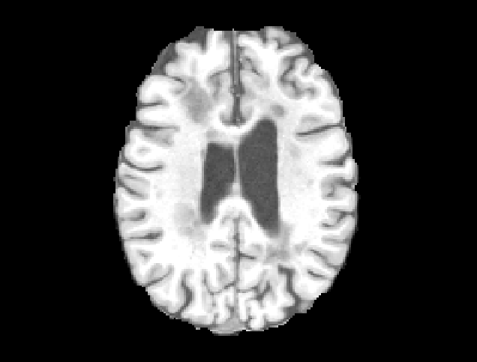
Segmentation
T1

Slide 28
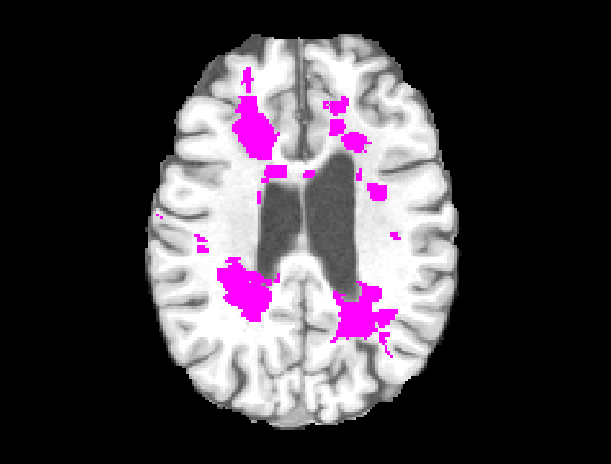
Segmentation
T1
+ Ground Truth
Segmentation

Slide 29
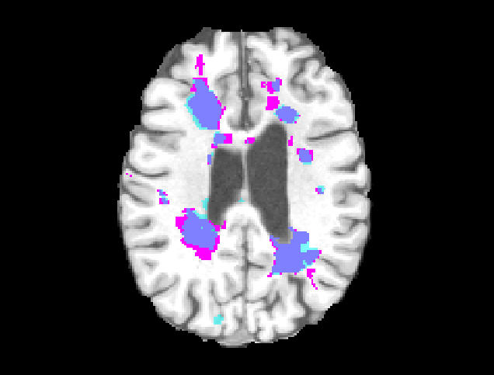
Segmentation
T1
+ Ground Truth
Segmentation
+ Model Segmentation

Slide 30
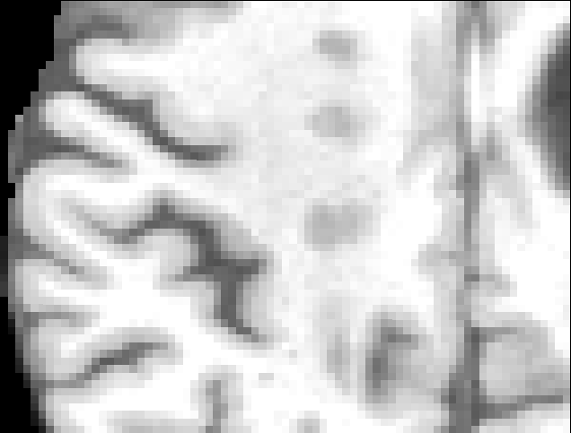
Segmentation
T1

Slide 31
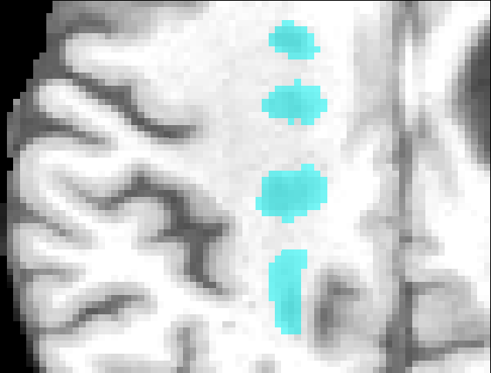
Segmentation
T1
+ Model Segmentation

Slide 32
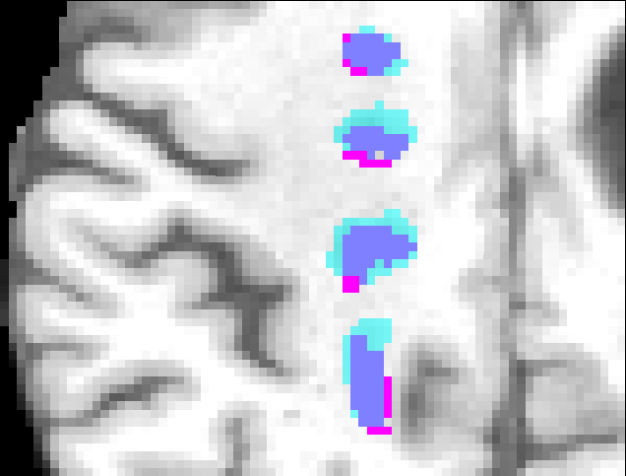
Segmentation
T1
+ Model
Segmentation
+ Ground Truth
Segmentation

Slide 33
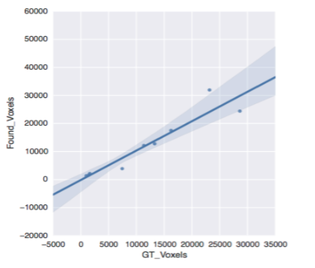
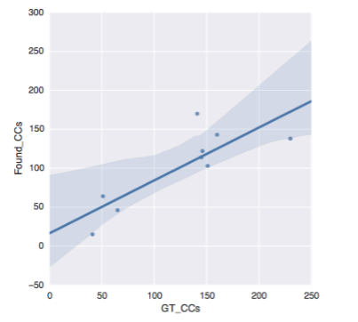
Lesion Load

Slide 34
5.CONCLUSION

Slide 35
Conclusions
Increasing patch size increases performance but also computational cost cubically.
Cascade helps to remove false positives.
Varying the number of classes has helped as in our case.
General pattern has been learned.
Some exceptions have not been learned (expert knowledge)

Slide 36
6.FUTURE WORK

Slide 37
Future Work
Conditional Random Fields of the CNN output to add more context
Initial unsupervised feature extraction with auto-encoders or RBMs
Outlier reduction
Increase the number of modalities used
Increase cascade levels

Slide 38

THANKS!
Any questions?
You can find me at
erolkazancli@gmail.com

Slide 39
CREDITS
Special thanks to
MintLabs,
Pablo Villoslada,
Hospital Clinic

